Slide 1
Sociology:
A Brief Introduction
Understanding Sociology

Slide 2
1
UNDERSTANDING SOCIOLOGY
What is Sociology?
The Development of Sociology
Major Theoretical Perspectives
Taking Sociology With You
Appendix: Careers in Sociology

Slide 3
A Look Ahead
How did sociology develop?
How does it differ from
other social sciences?
Who are the pioneers and what
are their theoretical perspectives?
How does sociology help us
develop a sociological imagination?

Slide 4

What is Sociology?
Sociology: Scientific study of social behavior and human groups
Focus on:
  How relationships influence people’s attitudes and behavior
  How societies
  develop and change

Slide 5
The Sociological
Imagination
C. Wright Mills describes
sociological imagination as:
An awareness of the relationship between an individual and the wider society
Ability to view
one’s society as
an outsider would

Slide 6
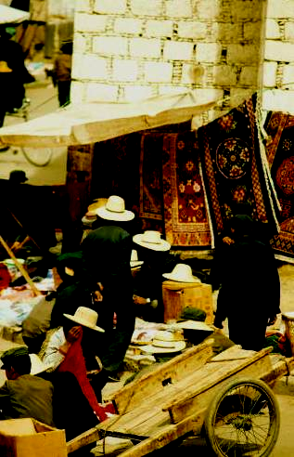
The Sociological
Imagination
Looks beyond a limited
understanding of human behavior
  See the world
  and its people
  in a new way
  See through a broader lens

Slide 7
Sociology and the Social Sciences
Science: Body of knowledge obtained by methods based on systematic observation
  Natural science: Study of physical features of nature and the ways they interact and change
  Social science: Study of social features of humans and the ways they interact and change

Slide 8
Sociology and the Social Sciences
Study influence society has on people’s attitudes and behavior
Seek to understand ways in which
people interact and shape society
Examine social relationships scientifically
  Study impact of earthquake that hit Port-au-Prince, Haiti
  Sociologists: long
  history of advising government agencies

Slide 9
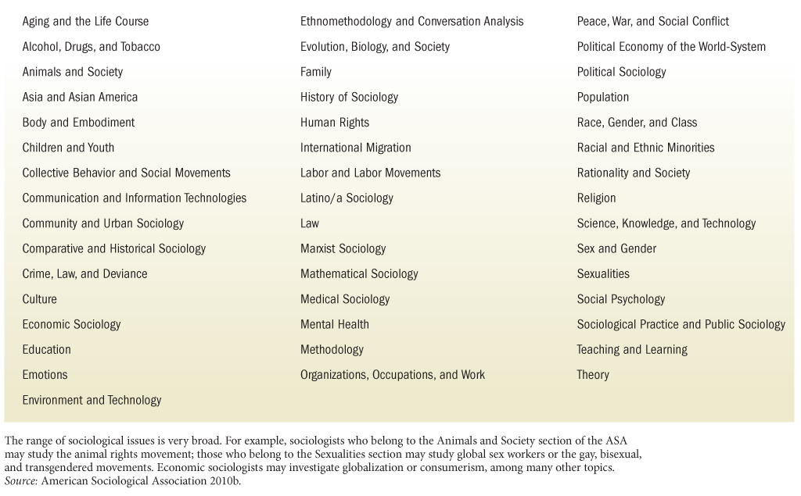
Table 1-1: Sections of the
American Sociological Association

Slide 10
Sociology and Common Sense
Sociologists do not accept something as fact because “everyone knows it”
  Each piece of information must
  be tested, recorded, and analyzed
  Women tend to be chattier than men
  Military marriages more likely to
  end in separation or divorce

Slide 11
What Is
Sociological Theory?
  Theory: Set of statements that seeks to explain problems, actions, or behavior
  Effective theories have
  explanatory and predictive power
  Theories are not final statements
  about human behavior
  Durkheim suicide studies:
  suggested suicide related to group life

Slide 12
The Development of Sociology
Philosophers/religious authorities of ancient and medieval societies made observations of human behavior
European theorists in 19th century made pioneering contributions to development of the science of human behavior

Slide 13
Early Thinkers
Auguste Comte (1798–1857)
  Systematic investigation of behavior
  needed to improve society
  Coined term “sociology”
Harriet Martineau (1802–1876)
  Studied social behavior in Britain and U.S.
  Emphasized impact of economy, law, trade, health, and population on social problems

Slide 14
Early Thinkers
Herbert Spencer (1820–1903)
  Studied “evolutionary” change in society
Émile Durkheim (1858–1917)
  Behavior must be understood
  within larger social context
  Anomie: Loss of direction felt in a society when social control of individual behavior becomes ineffective

Slide 15
Early Thinkers
Max Weber (1864–1920)
  To comprehend behavior, one must learn subjective meaning people attach to actions
  Verstehen: understanding; insight
  Ideal type: Construct for evaluating specific cases

Slide 16
Early Thinkers
Karl Marx (1818–1883)
  Society divided between two classes
  that clash in pursuit of interests
  Worked with Engels
  Emphasized group
  identification and
  associations that
  influence one’s
  place in society
  Working class
  should overthrow existing class system

Slide 17
Modern Developments
W. E. B. Du Bois (1868-1963)
  Black sociologists assisted struggle
  for racially egalitarian society
  Knowledge essential in combating prejudice
  In-depth studies of urban life
    Focused on religion at community level
  Double consciousness: Division
  of individual’s identity into
  two or more social realities

Slide 18
Twentieth-Century Developments
Charles Horton Cooley (1864–1929)
  Used sociological perspective
  to examine face-to-face groups
Jane Addams (1860–1935)
  Combined intellectual inquiry, social
  service work, and political activism
  Co-founded Hull House

Slide 19
Modern Developments
Robert Merton (1910–2003)
  Combined theory and research
  Developed explanation of deviant behavior
  Macrosociology: Concentrates on large-scale phenomena or entire civilizations
  Microsociology: Stresses study
  of small groups, often through experimental means

Slide 20
Modern Developments
Pierre Bourdieu (1930–2002)
  Capital sustains individuals and families from one generation to the next
  Cultural capital: noneconomic goods reflected in knowledge of language and arts
  Social capital: collective benefit of social networks

Slide 21

Major Theoretical Perspectives
Functionalist perspective
Conflict perspective
Interactionist perspective

Slide 22
Functionalist Perspective
Emphasizes the way parts of a society are structured to maintain its stability
  Talcott Parsons (1902–1972)
    Viewed society as vast
    network of connected parts
    Each helps maintain
    the system as a whole

Slide 23
Functionalist Perspective
  Manifest functions: Institutions are open, stated, conscious functions that
  involve intended and recognized consequences of an aspect of society
  Latent functions: Unconscious or unintended functions that may reflect
  hidden purposes of an institution
  Dysfunctions: Elements or processes
  of society that may disrupt a
  social system or reduce its stability

Slide 24
Conflict Perspective
Assumes social behavior best understood in terms of conflict or tension between competing groups
The Marxist view: Conflict is part
of everyday life in all societies
  Conflict theorists interested in how institutions may help maintain privileges of some groups and keep others subservient

Slide 25
Conflict Perspective
The Feminist view
  Sees inequality in gender as
  central to all behavior and organization
  Often allied with conflict theory
  Proponents tend to focus on macro level
  Broadened social behavior by extending analysis beyond male point of view

Slide 26
Interactionist Perspective
Generalizes about everyday
forms of social interaction to
explain society as a whole
  Humans viewed as living in
  a world of meaningful objects
  Nonverbal communication: Includes
  gestures, facial expressions, and postures

Slide 27
Interactionist Perspective
“Slugging”
Tattoos
Dress codes

Slide 28
Interactionist Perspective
George Herbert Mead (1863–1931)
  Regarded as founder of
  interactionist perspective
Erving Goffman (1922–1982)
  Dramaturgical approach:
  People seen as
  theatrical performers

Slide 29
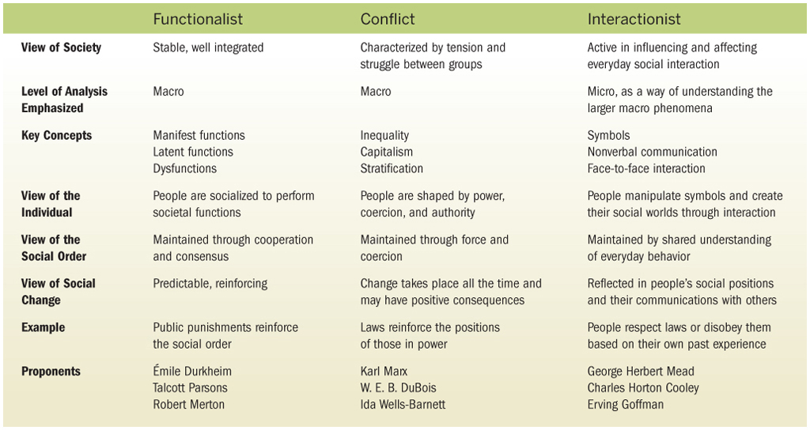
Table 1-2: Major Sociological Perspectives

Slide 30
The Sociological Approach
Gain broadest understanding of society by drawing on all major perspectives, noting where they overlap or diverge
  Each perspective offers unique
  insights into the same issue
Researcher’s work always guided
by his or her theoretical viewpoint

Slide 31
Research Today
1.1: Looking at Sports from Four Theoretical Perspectives
  Have you experienced or witnessed discrimination in sports based on gender or race? If so, how did you react?
  Which perspective do you think is
  most useful in looking at the
  sociology of sports?

Slide 32
Video: The Philippines
View video

Slide 33
Video: Malawi
View video

Slide 34
Applied and Clinical Sociology
Applied sociology: Use of sociology with intent of yielding practical applications for human behavior and organizations
Clinical sociology: Facilitating
change by altering social relationships
or restructuring
social institutions
  Basic sociology: Seeks profound knowledge
  of fundamental aspects of social phenomena

Slide 35
Developing a Sociological Imagination
Theory in Practice
Research Today
Thinking Globally
  Globalization: Worldwide integration of government policies, cultures, social movements, and financial markets through trade and the exchange of ideas

Slide 36
Developing a Sociological Imagination
The Significance of Social Inequality
  Social Inequality: Condition in which members of society have differing
  amounts of wealth, prestige, or power
Speaking Across Race,
Gender, and Religious Boundaries
Social Policy throughout the World

Slide 37
Sociology in the Global Community
1.2: Your Morning Cup of Coffee
  Would you willingly pay more for a
  cup of coffee if you knew that
  the worker who picked the beans
  would benefit from the higher price?
  The coffee trade has been blamed for perpetuating social inequality, warfare, and global warming. Can you think of any positive effects of the coffee trade?

Slide 38

Careers in Sociology
Number of students graduating with degree in sociology has risen steadily
  Provides strong liberal arts background
  for entry-level positions
    Business
    Social services
    Foundations
    Community organizations
    Law enforcement
    Government

Slide 39
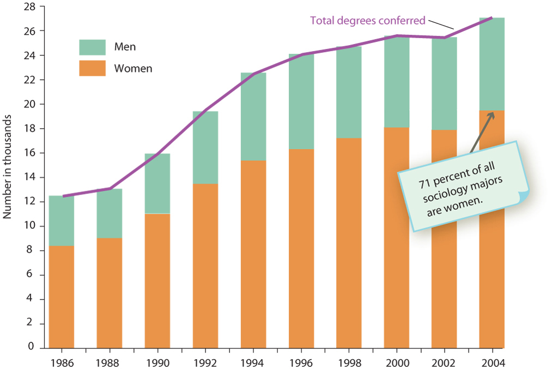
Figure 1-2: Sociology Degrees
Conferred in the United States by Gender

Slide 40

Figure 1-3: Occupations of
Graduating Sociology Majors

